Slide 1
Computer Networks
by
Surendra Kr.Keshari
Assistant Professor
KIET Group of Institutions

Slide 2
Link layer switches & bridges
(Learning bridge and spanning tree algorithms)

Slide 3
Data Link Layer Switching
Data link layer is the second layer of the Open System Interconnections (OSI) model whose function is to divide the stream of bits from physical layer into data frames and transmit the frames according to switching requirements.
Network switching is the process of forwarding data frames or packets from one port to another leading to data transmission from source to destination.
Switching in data link layer is done by network devices called bridges.

Slide 4
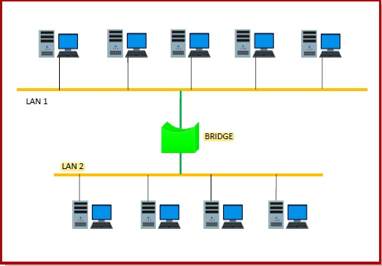
Bridges/ LAN Switch/ Ethernet Switch
  A data link layer bridge connects multiple LANs (local area networks) together to form a larger LAN. This process of aggregating networks is called network bridging. A bridge connects the different components so that they appear as parts of a single network.

Slide 5
Switching by Bridges
  When a data frame arrives at a particular port of a bridge, the bridge examines the frame’s data link address, or more specifically, the MAC address. If the destination address as well as the required switching is valid, the bridge sends the frame to the destined port. Otherwise, the frame is discarded.
  The bridge is not responsible for end to end data transfer. It is concerned with transmitting the data frame from one hop to the next. Hence, they do not examine the payload field of the frame. Due to this, they can help in switching any kind of packets from the network layer above.
  Bridges also connect virtual LANs (VLANs) to make a larger VLAN.
  If any segment of the bridged network is wireless, a wireless bridge is used to perform the switching.

Slide 6
Bridges
  Goal:
  Self-configuring without hardware or software changes Bridges should not impact operation of existing LANs.
  Three parts to understanding bridges:
  (1) Forwarding of Frames
  (2) Learning of Addresses
  (3) Spanning Tree Algorithm

Slide 7
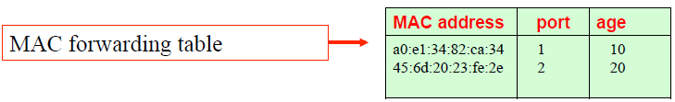
Forwarding of Frames
  Each bridge maintains a MAC forwarding table
  Forwarding table plays the same role as the routing table of an IP router
  Entries have the form ( MAC address, port, age), where
  MAC address: host name or group address
  port: port number of bridge
  age: aging time of entry (in seconds)

Slide 8
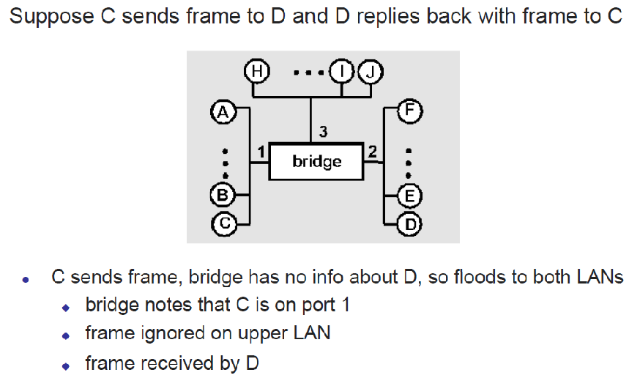
Learning Bridges

Slide 9
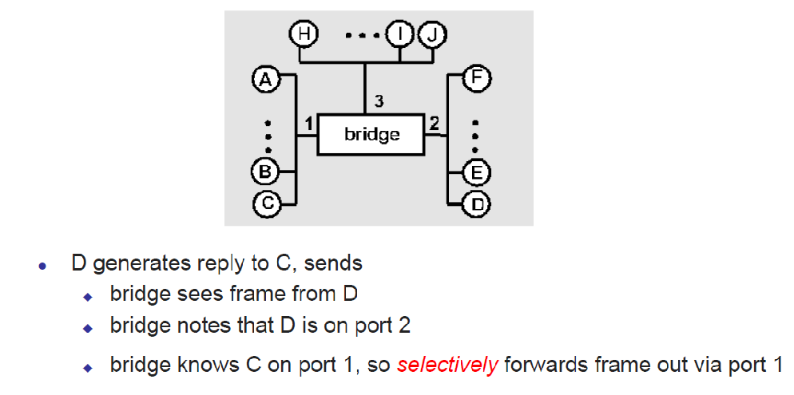
Learning Bridges

Slide 10
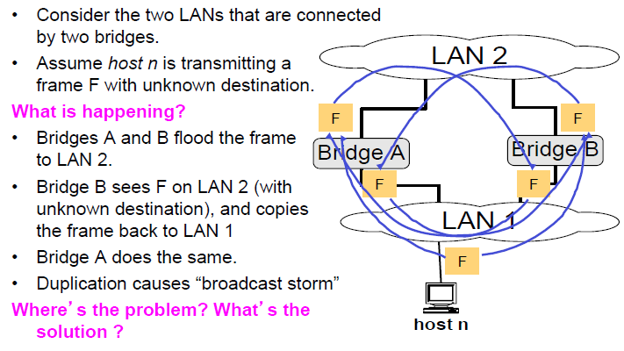
Problems with network of bridges

Slide 11
Spanning Tree Protocol
  Reasons for deploying the Spanning Tree Protocol:
  Loop avoidance
  Redundant links
  Protocol Versions:
  IEEE 802.1D Spanning Tree Protocol (STP)
  IEEE 802.1w Rapid Spanning Tree Protocol (RSTP)
  IEEE 802.1s Multiple Spanning Tree Protocol (MSTP)

Slide 12
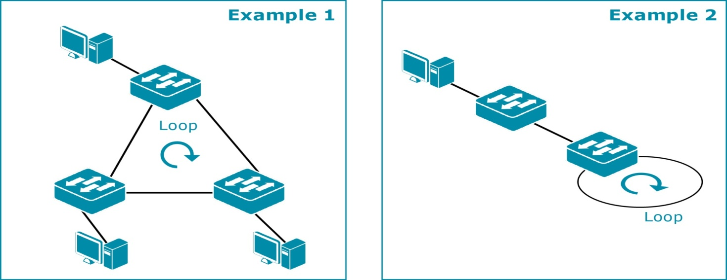
Loop Issue without STP
A loop is not allowed in an L2 Ethernet network. If there is a loop, it will create a broadcast storm which will bring the network operation down.

Slide 13
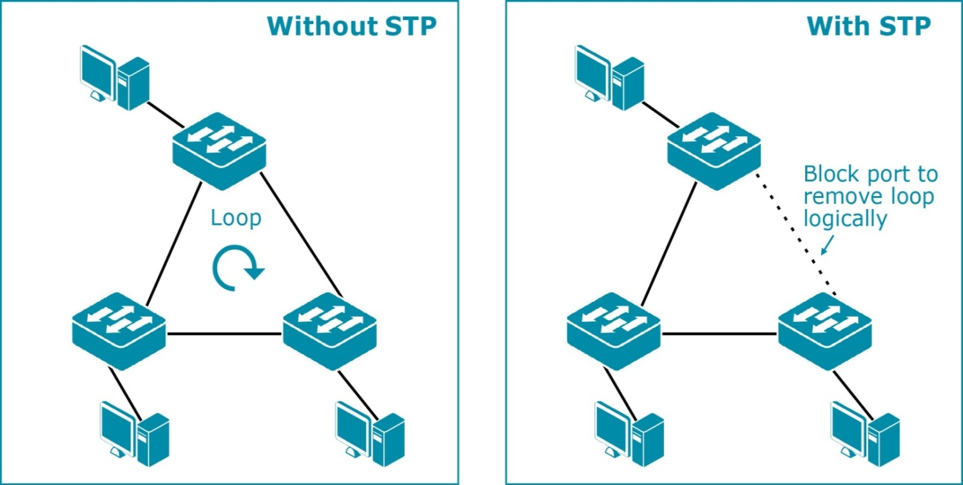
Loop Avoidance
The Spanning Tree Protocol can resolve loop issues

Slide 14
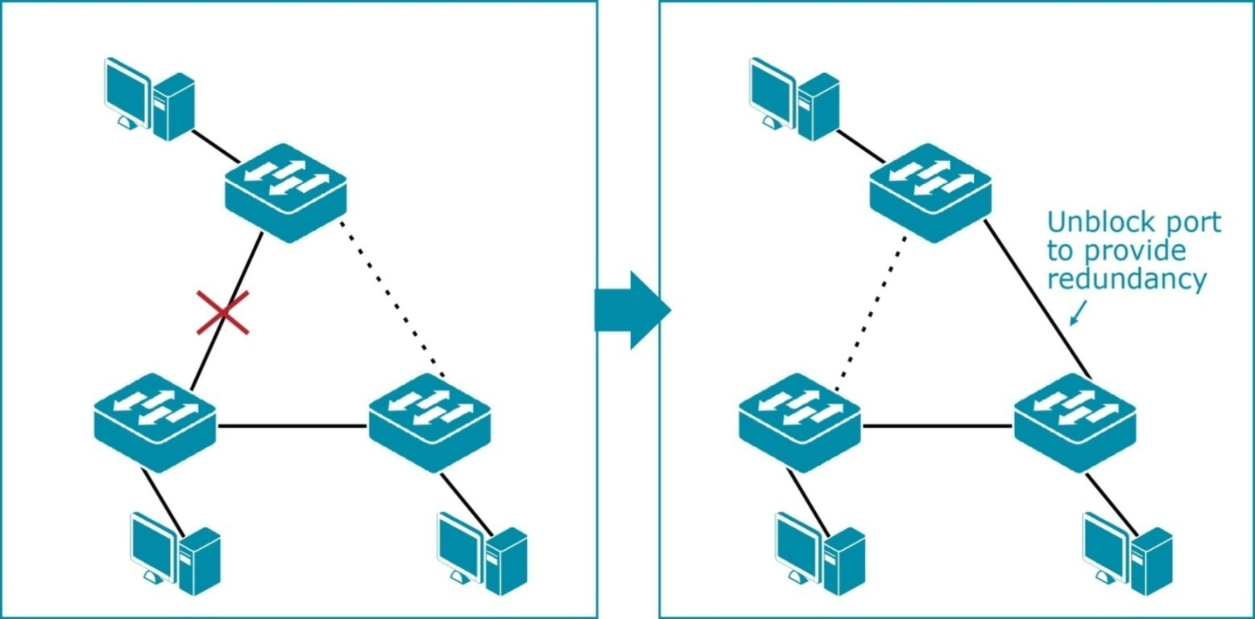
Redundant Links
If one of the connections fails, the Spanning Tree Protocol will unblock the port and provide redundancy.

Slide 15
Bridge Protocol Data Unit (BPDU)
The Spanning Tree Protocol is defined in IEEE 802.1D.
All switches/bridges in the network gather information about other switches through data message exchange. These messages are called Bridge Protocol Data Units (BPDU).
BPDUs are used to calculate the spanning tree.

Slide 16
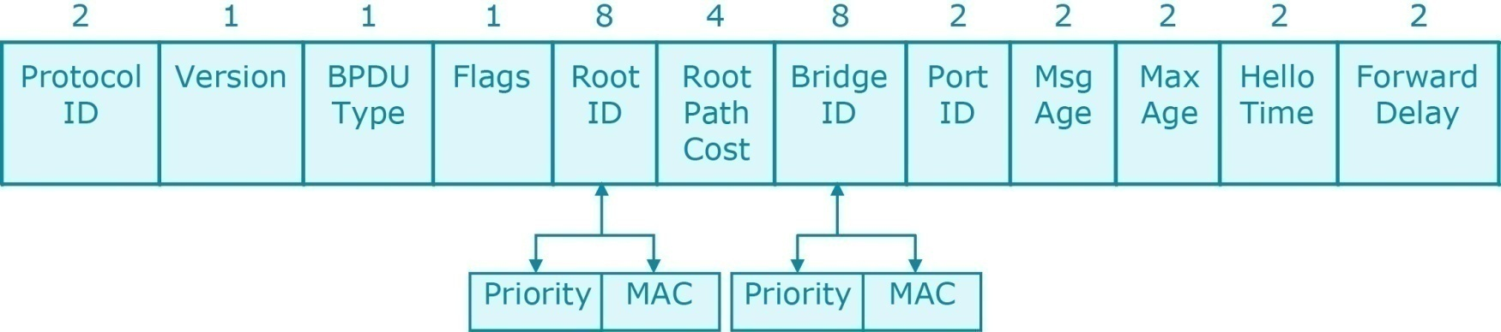
Bridge Protocol Data Unit (BPDU)
A BPDU is a data frame used by the Spanning Tree Protocol. It is used to exchange essential information between switches to derive path information. The exchange is done every two seconds by default so that the switches can keep track of the network changes.
The IEEE 802.1D STP multicast destination address for BPDU is 01-80-C2-00-00-00.

Slide 17
BPDU Frame Format
Field | Bits | Use
Protocol ID | 16 | Always 0
Version | 8 | Always 0
BPDU Type | 8 | Type of current BPDU Flag: 00=Configuration BPDU, 01=Topology Change (TC)
Flags | 8 | LSB=Topology Change (TC) Flag MSB=Topology Change Acknowledgement (TCA) Flag
Root ID | 64 | Bridge ID of current Root Bridge
Root Path Cost | 32 | Cumulative cost of Root Bridge
Bridge ID | 64 | Bridge ID of current bridge
Port ID | 16 | Unique ID for port that sent this BPDU
Message Age | 16 | Time since Root Bridge created – BPDU used to derive current BPDU
Max. Age | 16 | Period to save BPDU information
Hello Time | 16 | Period between BPDUs
Forward Delay | 16 | Time spent in Listening and Learning states

Slide 18
What do the BPDUs do?
With the help of the BPDUs, bridges can:
Elect a single bridge as the root bridge.
Calculate the distance of the shortest path to the root bridge
Each LAN can determine a designated bridge, which is the bridge closest to the root. The designated bridge will forward packets towards the root bridge.
Each bridge can determine a root port, the port that gives the best path to the root.
Select ports to be included in the spanning tree.

Slide 19
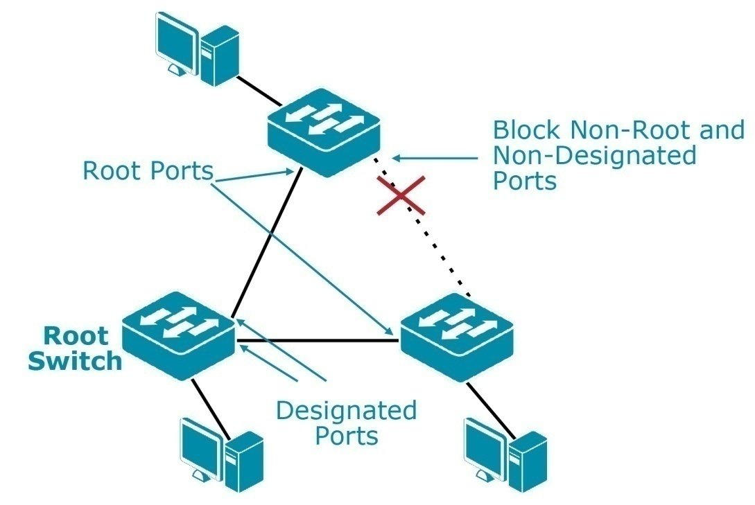
802.1D Spanning Tree Protocol (STP)
Find the Root Switch.
Find the Root Port for each switch.
Find the Designated Port for each LAN segment.
Block the port(s) which is/are not Root Port(s) or Designated Port(s).

Slide 20
What is a Root Switch?
Bridge ID:
  Each switch has a unique Bridge ID, which is an 8-byte value consisting of the following fields:
    Bridge Priority (2 bytes)
    MAC Address (6 bytes)
Rule for electing the Root Switch:
  The bridge with the lowest Bridge priority is elected as the Root Switch.
  If the priority value is identical, the bridge with the lowest MAC address is elected as the Root Switch.

Slide 21
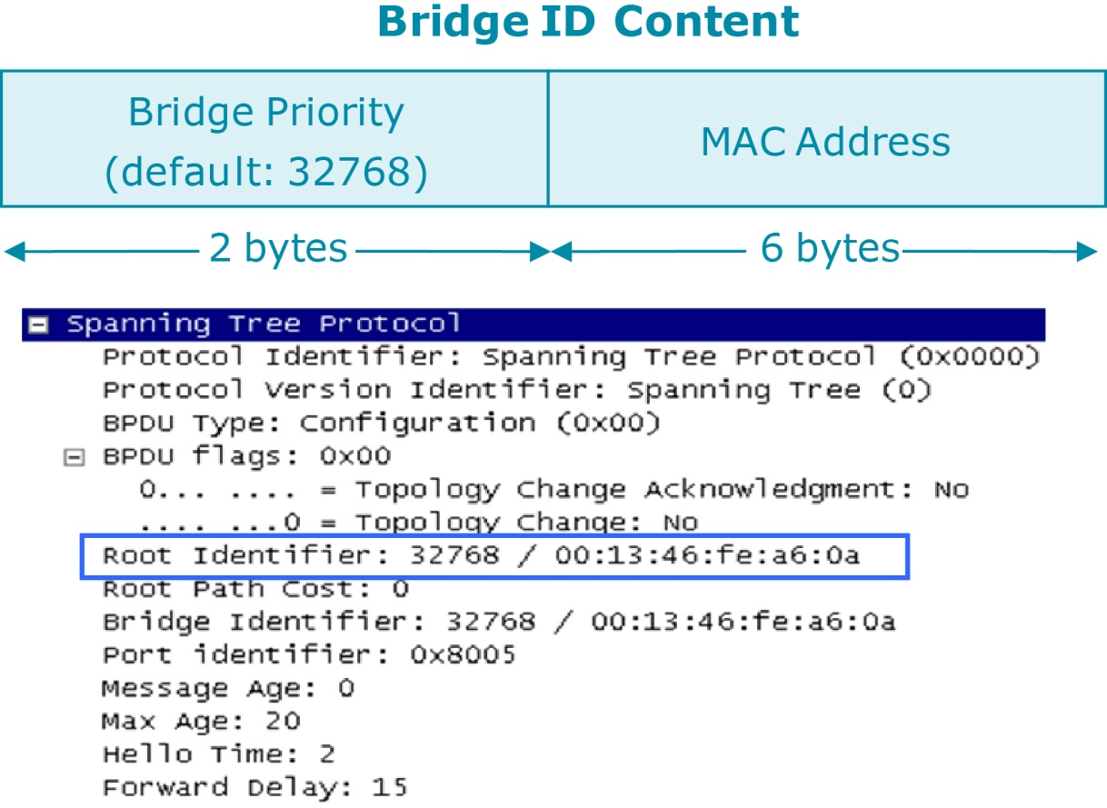
Bridge ID Content

Slide 22


An illustration of the STP process
Switch 1
1
Each bridge assumes it is the root bridge, places its Bridge ID as the root ID and sends Hello BPDUs out.
<Root Bridge ID, Root Path Cost, Sender Bridge ID>
Root Bridge
Priority: 32768
MAC: 00-00-00-00-00-0a
3
1
After a root is chosen, only root bridge sends Hello BPDUs, but other switches forward them
1
Switch 3
3
Priority: 32768
MAC: 00-00-00-00-00-0c
2
2
3
Switch 2
Priority: 32768
MAC: 00-00-00-00-00-0b
2
Each bridge compares its Bridge ID with the root ID field of the Configuration BPDUs received. If it is lower, the Bridge replaces its Bridge ID in the root ID field to become the root Bridge.

Slide 23
Electing Root Ports and Designated Ports
Electing Root Ports
  The reference point (Root Bridge) has been elected for the entire switched network; Each non-root switch must figure out where it is in relation to the Root Bridge. This action can be performed by selecting only one Root Port on each non-root switch.
  Selecting a Root Port involves evaluating the Root Path Cost. This value is the cumulative cost of all the links leading to the Root Bridge. Remember that only the Root Path Cost is carried inside the BPDU.
Electing Designated Ports
  To remove the possibility of bridging loops, STP makes a final computation to identify one Designated Port on each network segment.
  The switch chooses a Designated Port based on the lowest cumulative Root Path Cost to the Root Bridge.

Slide 24
How does STP select a path?
Decision List:
  Root Bridge ID
  Path Cost to the Root Bridge
  Sender Bridge ID
  Port Priority
  Port ID

Slide 25
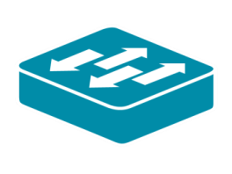
Electing the Root Port and Designated Port
<Root Bridge ID, Root Path Cost, Sender Bridge ID>
Switch A
32768, 00-00-00-00-00-0a
Designated Port
Designated Port
AP1
AP2
Root Bridge
<A,0,A>
<A,0,A>
AP1 vs BP1
AP1 Priority > BP1 Priority
AP2 vs CP1
AP2 Priority > CP1 Priority
Designated Port
Path Cost: 10
Path Cost: 5
CP2 -> SW A = 4+5 = 9
CP1 -> SW A = 10
<A,0,A>
Root Port
<B,0,B>
<A,0,A>
BP1
<C,0,C>
Root Port
CP1
BP2
Path Cost: 4
CP2
<B,0,B>
<A,10,A>
<A,5,A>
<C,0,C>
Switch B
<A,9,A>
Switch C
32768, 00-00-00-00-00-0b
Designated Port
32768, 00-00-00-00-00-0c
BP1 vs BP2
BP1 Priority > BP2 Priority
Root Port
CP1 vs CP2
CP1 Priority > CP2 Priority
BP2 Priority > CP2 Priority

Slide 26
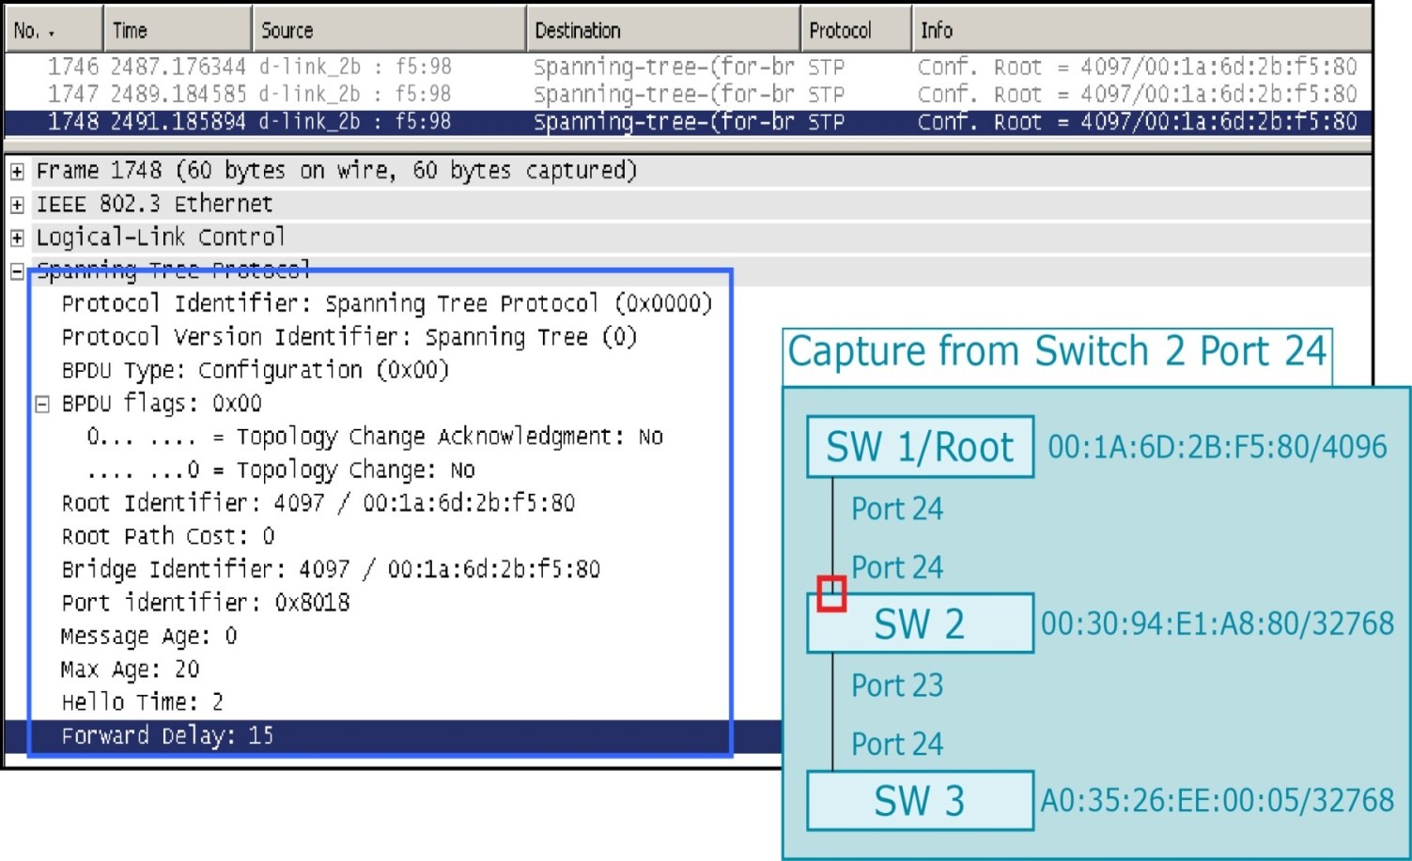
BPDU Parameter

Slide 27
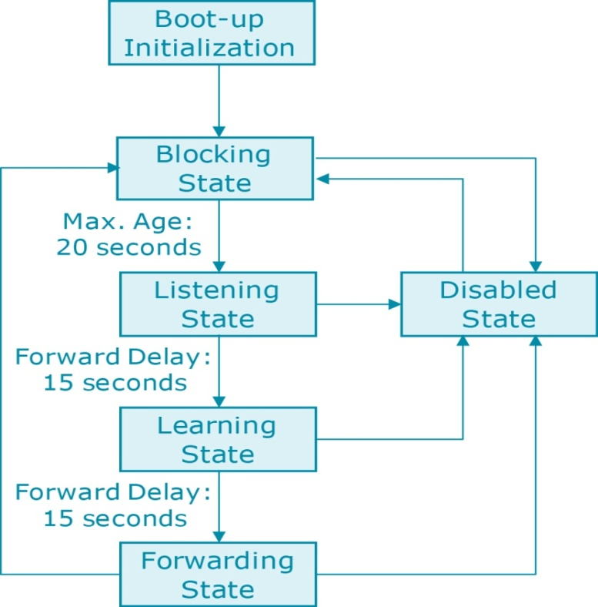
State of Ports on Switch
Blocking
  Just listen to incoming BPDUs
  The port does not learn MAC addresses of received frames
Listening
  Have to determine Root Port & Designated Port, but cannot learn the MAC addresses and forward the frames
Learning
  Port starts to learn the MAC addresses from incoming frame, but cannot forward the frames
Forwarding
  Start to forward frames
Disabled
  Port does not participate in STP, and does not forward frames

Slide 28
STP Converge Time
STP (802.1D) generally takes at least 30 to 50 seconds to converge (from Blocking state to Forwarding state).
  Listening (15s) + Learning (15s) = 30 seconds
  Max. Age (20s) + Listening (15s) + Learning (15s) = 50 seconds
A disadvantage of STP is the slow convergence speed.
Solution:
  IEEE 802.1w Rapid Spanning Tree Protocol (RSTP)
  RSTP provides significant improvements in the speed of convergence for a switched network by transitioning Root and Designated Ports to the Forwarding state immediately.
  With RSTP, packets are forwarded depending on different Port States.
  RSTP reconfigures the spanning tree in less than one second (compared to 50 seconds for STP).

Slide 29
References
  Behrouz Forouzan, “Data Communication and Networking”, McGraw Hill
  Andrew Tanenbaum “Computer Networks”, Prentice Hall.
  William Stallings, “Data and Computer Communication”, Pearson.
  Kurose and Ross, “Computer Networking- A Top-Down Approach”, Pearson.
  Peterson and Davie, “Computer Networks: A Systems Approach”, Morgan Kaufmann
  W. A. Shay, “Understanding Communications and Networks”, Cengage Learning.
  D. Comer, “Computer Networks and Internets”, Pearson.
  DCS D-Link Academy.

Slide 30
Thank
You

